Slide 1
Interactive Sales Financial
Dashboard

Slide 2
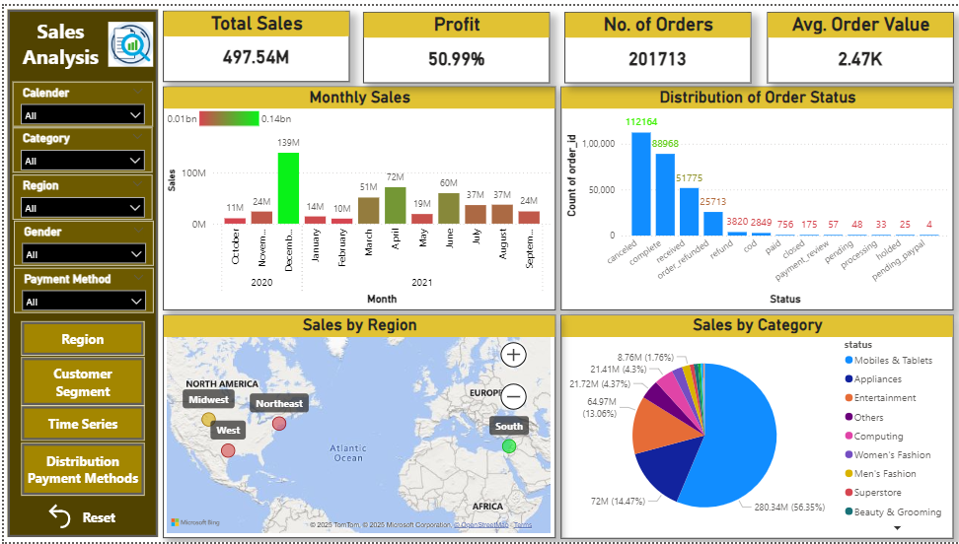

Slide 3
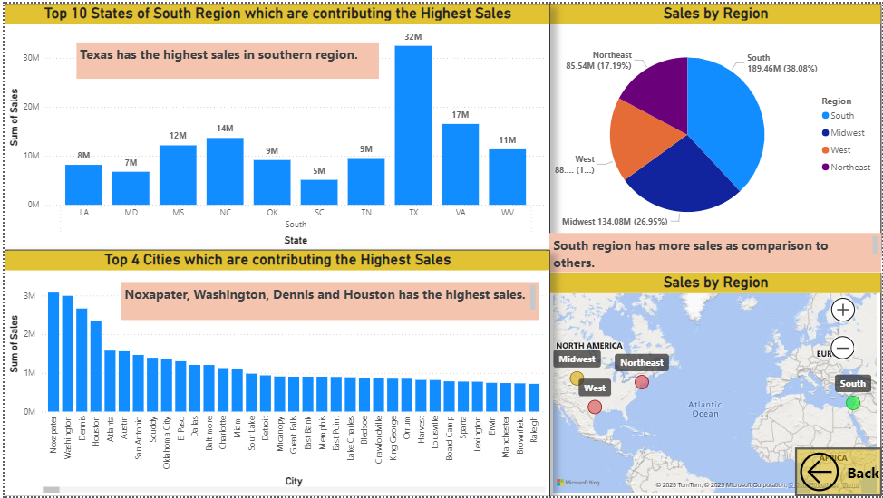
REGION

Slide 4
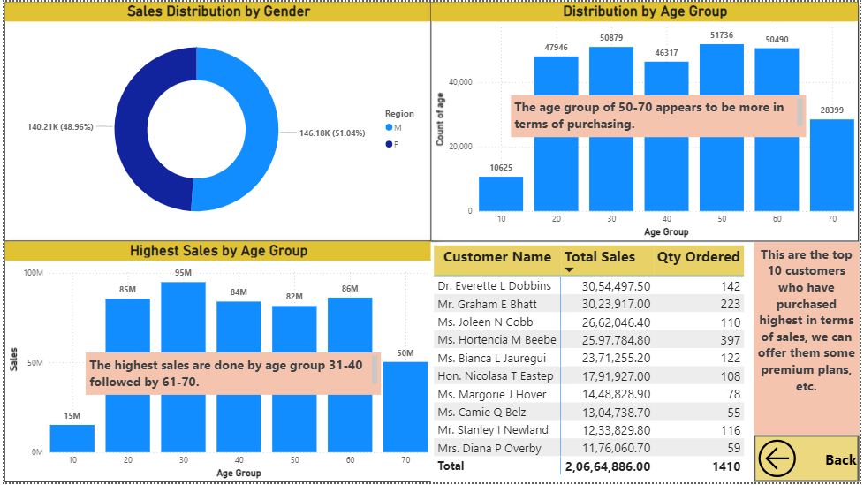
CUSTOMER SEGMENTATION

Slide 5
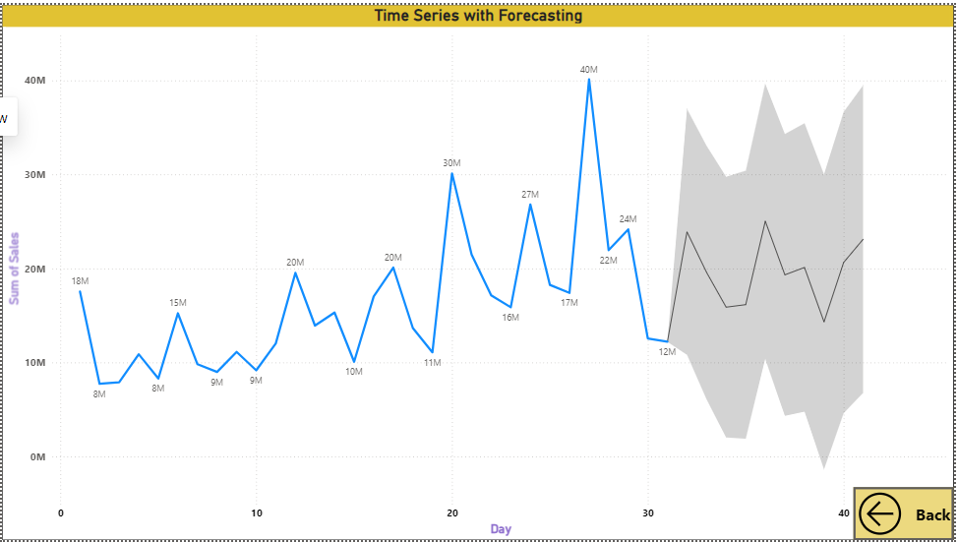
TIME SERIES WITH FORECASTING FOR 12 DAYS

Slide 6
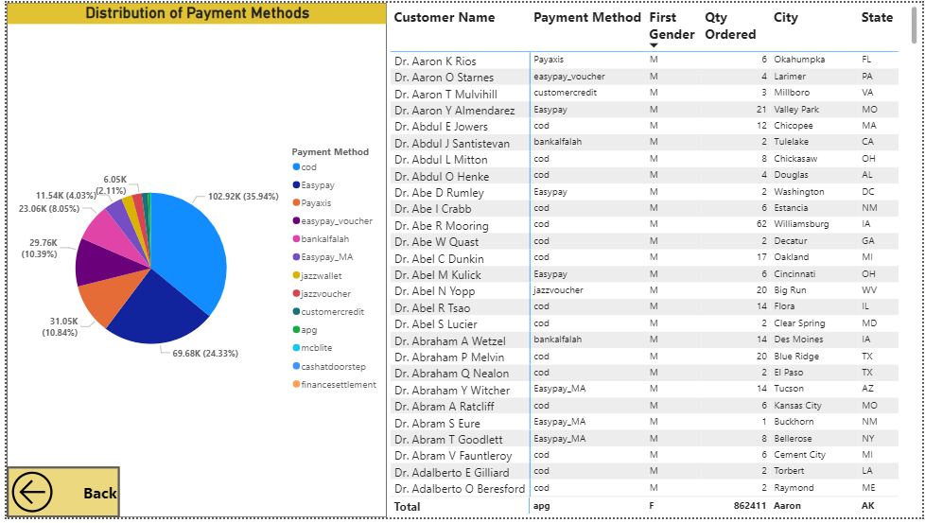
DISTRIBUTION OF PAYMENT METHODS

